Slide 1
Data Structures and Algorithms -3
(25CS2103E)
Network Flow Optimization Engine for Data
Center Traffic Routing
Team Members
Name: Sai kiran - 2520030125
Name: Harshith - 2520030393
Name: SATHVIK - 2520030226
Under the Esteemed Guidance of
Swathi D, Computer Science Engineering

Slide 2
Contents
1. Abstract
2. Introduction
3. Literature Survey
4. Problem Statement & Objectives
5. Flow Chart
6. Results
7. Hardware & Software Requirements
8. Conclusion
9. Future Scope

Slide 3
Abstract
Problem Statement
Solution
Modern cloud data centers and Content Delivery Networks (CDNs) face bandwidth congestion and high runtime overhead when computing maximum flow on large, sparse topologies using traditional single-path algorithms like Edmonds–Karp ($O(V E^2)$).
A high-performance Network Flow Optimization Engine using Dinic’s Algorithm ($O(V^2 E)$). It features a hand-built Forward-Star array layout (head[], to[], next[], capacity[], flow[], ptr[]) without java.util.* dependencies to optimize CPU cache locality, custom BFS array queues, and batch blocking-flow DFS pushes
Comparative empirical benchmarking of execution speedup and memory footprint reduction between Dinic's Algorithm and Edmonds–Karp across large sparse graphs.
Input & Output Demonstration
Analysis Statement
Input: Network topology graphs (up to 10,000+ nodes) and live data streaming bandwidth configurations in Mbps/Gbps.
Comparative empirical benchmarking of execution speedup and memory footprint reduction between Dinic's Algorithm and Edmonds–Karp across large sparse graphs.
Output: Real-time visual tracking of step-by-step execution—including BFS level graphs ($L_0, L_1, \dots, L_k$), DFS blocking flows, and the Max-Flow Min-Cut boundary that isolates physical link bottlenecks.

Slide 4
Introduction
Core Limitation: Edmonds–Karp (O(VE^2)) causes high overhead due to single-path augmentations.
Web Architecture
Input files/folders → Analysis of Data → Raw binary data → Transporting through fiber cables → Data centres → Results Dashboard
Background: Modern cloud Content Delivery Networks (CDNs) require high-throughput routing, but traditional algorithms like Dijkstra cannot load-balance across parallel channels.
User Experience
The user will insert files and folders in this and the system will convert it into raw data and show how the data is being sent and received from the user and the data centers this process continues as a loop non stop
Key Features: A dual-mode architecture combining a large-scale graph benchmarker with an interactive CDN Traffic Simulator for real-time bottleneck analysis.

Slide 5
Literature Survey
Ford–Fulkerson Method (1956): Introduced residual graphs and augmenting paths, but $O(E \cdot F)$ complexity is inefficient for large capacities.
Edmonds–Karp Algorithm (1972): Uses BFS for shortest path finding (O(VE^2)), but single-path updates cause high latency on large sparse networks
Dinic’s Algorithm (1970): Uses Level Graphs (BFS) and Blocking Flows (DFS) to process paths in batch waves, reducing complexity to O(V^2E).
Data Center Systems Design: Modern cloud networks use flat primitive arrays over

Slide 6
Problem Statement and Objectives
Problem Statement
Shortest-path algorithms (Dijkstra) cannot load-balance, while classic max-flow algorithms (Edmonds–Karp, $O(VE^2)$) process paths individually, creating high latency. Additionally, standard collections
High-Performance Core Engine: Implement Dinic’s Algorithm ($O(V^2E)$) with Level Graphs and batch Blocking Flows.
Zero: Build Forward-Star arrays and custom queues using primitive arrays to maximize CPU cache locality.
CDN Traffic Simulation: Create an interactive visual interface mapping theoretical networks to real-world traffic in Mbps/Gbps.
Benchmarking & Bottlenecks: Isolate network constraints via Max-Flow Min-Cut and compare runtimes against Edmonds–Karp.

Slide 7
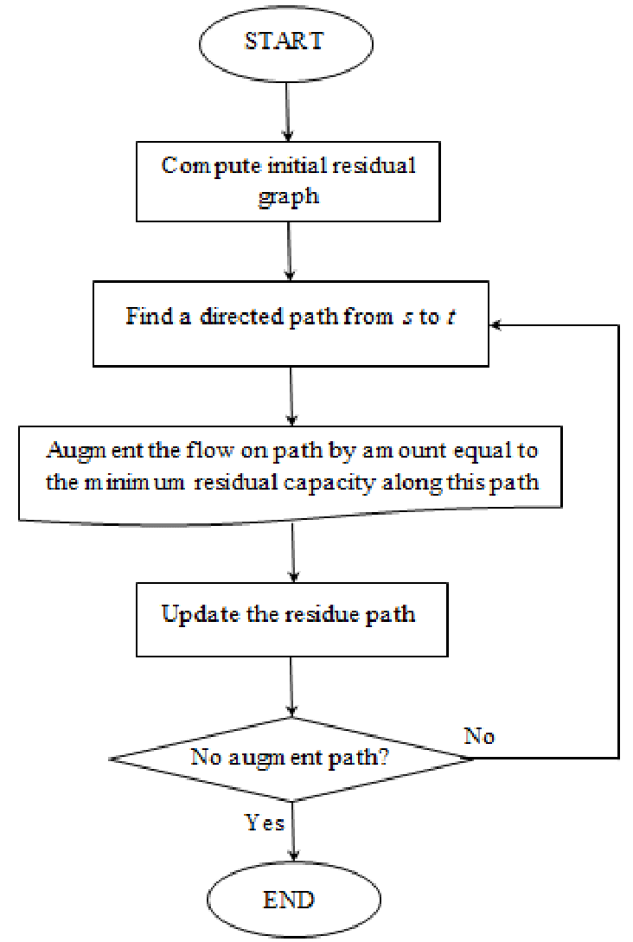
Flow Chart

Slide 8
Results
1. Algorithmic Scaling & Batching Efficiency
The Paradigm Shift: Traditional algorithms like Edmonds–Karp (O(VE^2)) run a full BFS per path, creating massive O(VE) traversal overhead on sparse graphs.
Dinic’s Advancement: Using BFS Level Graphs and DFS Batch Blocking Flows (O(V^2E)), Dinic’s engine achieves up to 15\times speedups over Edmonds–Karp on large topologies (V=10\text{k}, E \approx. 30\text{k}).
2. Real-World CDN & Data Center Application
Multi-Path Load Balancing: Unlike shortest-path algorithms (e.g., Dijkstra) that over-saturate single routes, max-flow balances traffic across parallel channels.
Min-Cut Infrastructure Diagnostics: The Minimum Cut boundary identifies fully saturated links (100% utilization), revealing exact fiber-optic bottlenecks for capacity upgrades.

Slide 9
Hardware and Software requirements
Hardware
Software
JDK: 17+ (core strictly zero
Build Tool: Maven / Gradle
UI: JavaFX / Web Stack (HTML5 Canvas + JS
+ Java backend)
Benchmarking: JMH /
OS: Windows, macOS, Linux
CPU: Dual-Core 2.0 GHz+ (x86_64 / ARM64)
RAM: 4 GB min (8 GB for 10,000+ node testing)
Storage: 200 MB free
Display: 1080p (1920×1080)
Project UI / Styling
Input / Output
• Inter and JetBrains Mono fonts
• Academic Green & Black visual system in the
website
• Responsive dashboard layout
• Local browser processing of input text
Input: typed/pasted text or .txt, .md, .csv, .log, .fasta files.
Output: Raw data to data centers
visualization, performance comparison and high maintanence.

Slide 10
Conclusion
Core Achievement: Developed a high-performance Network Flow Optimization Engine using Dinic’s Algorithm (O(V^2E)) with zero java.util.* dependencies, utilizing custom Forward-Star primitive arrays for optimized CPU cache locality.
Performance Gain: Demonstrated multi-fold speedups and lower memory overhead compared to Edmonds–Karp (O(VE^2)) when computing maximum flow across large-scale, sparse network topologies.
Real-World Utility: Successfully combined an abstract graph benchmarker (10,000+ nodes) with an interactive CDN Traffic Simulator, enabling real-time visualization of BFS level graphs, DFS blocking flows, and Min-Cut bottleneck isolation.

Slide 11
Future Scope
Dynamic Real-Time Re-Capacitation
Adapt to link failures and live traffic changes without full graph recomputation.
Parallel & GPU Acceleration
Min-Cost Max-Flow (MCMF)
Autonomous AI Rerouting
Multi-thread BFS and DFS execution via CUDA kernels for multi-million-node topologies.
Optimize for routing latency and financial transit costs alongside raw throughput.
Integrate predictive ML models to forecast traffic spikes and reroute workloads before bottleneck saturation.

Slide 12
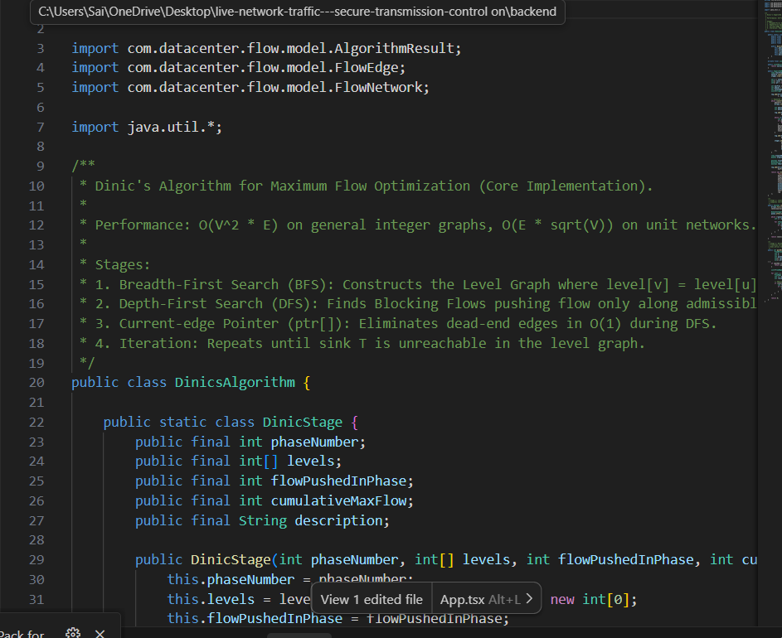
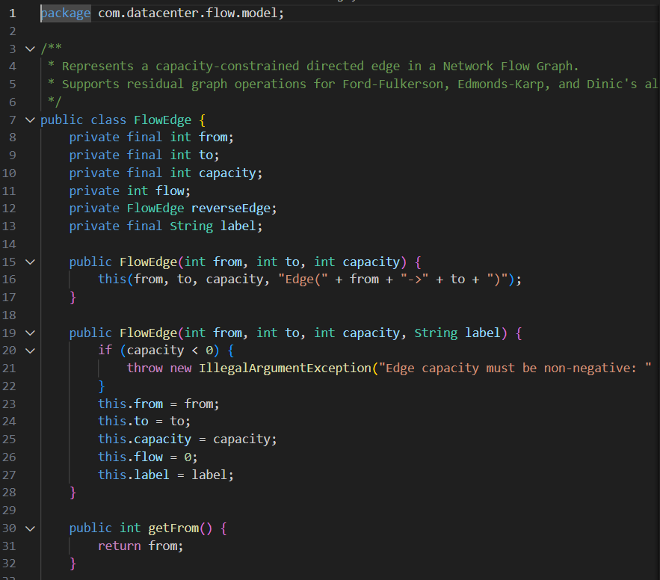
Sample Code

Slide 13
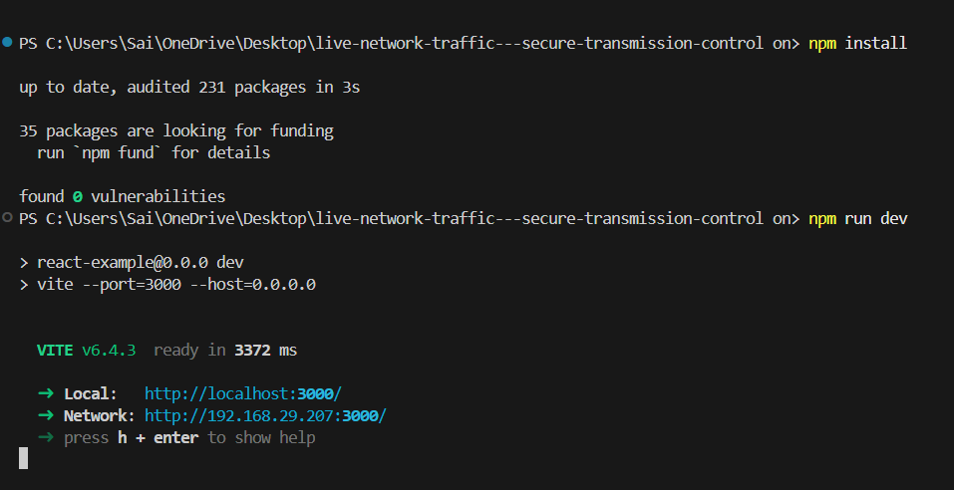
Code Execution

Slide 14
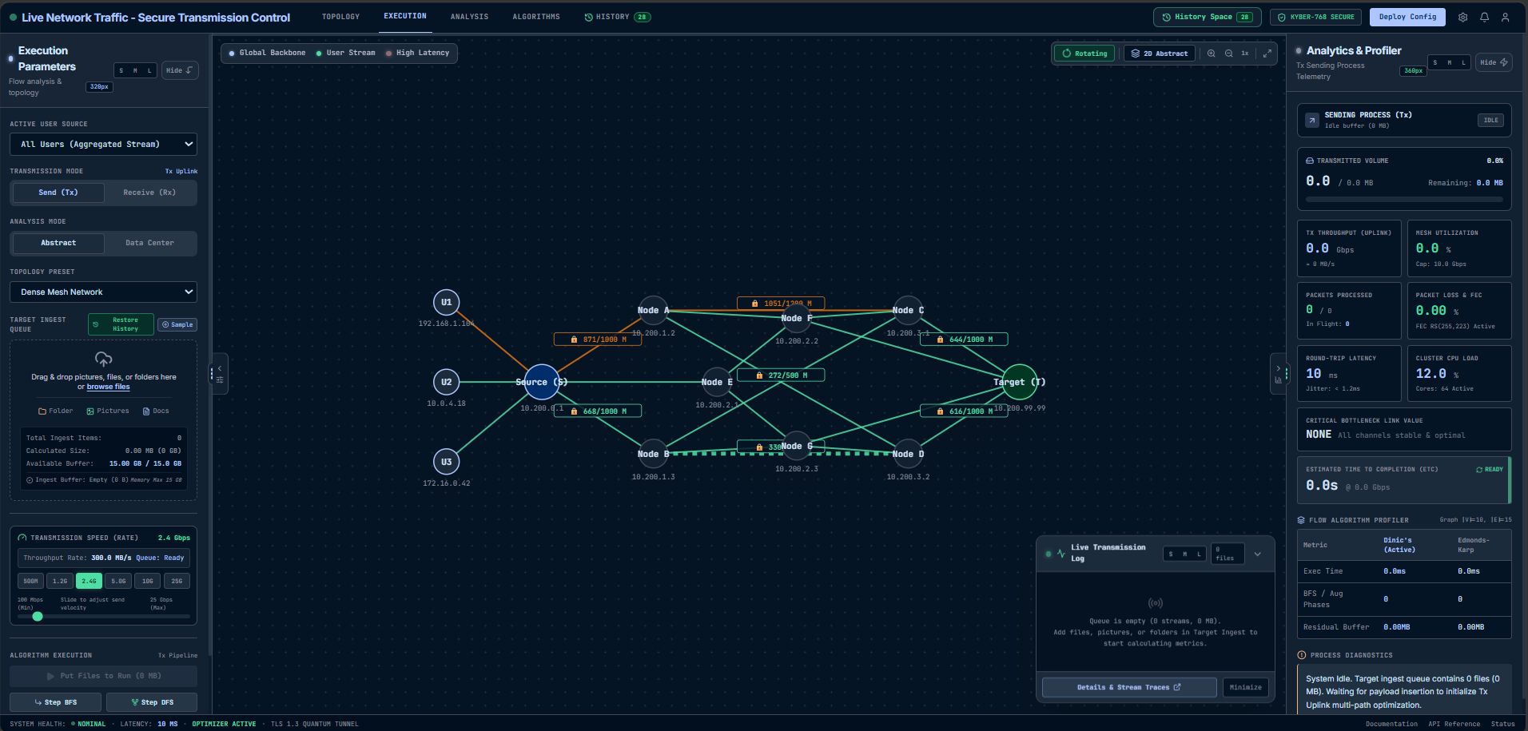
Web page

Slide 15
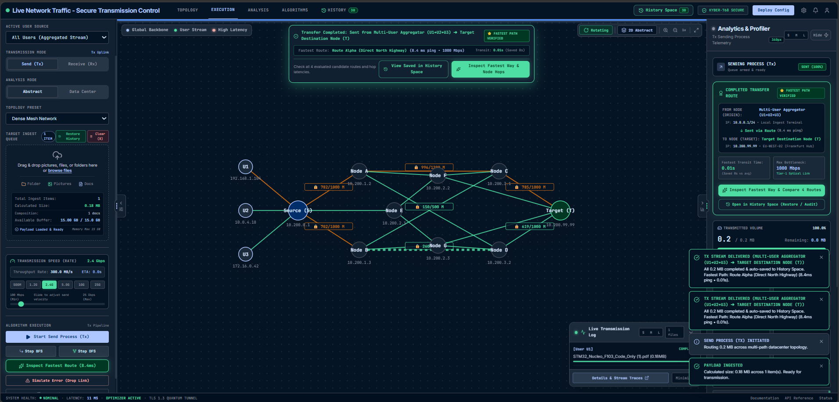
Page Execution

Slide 16
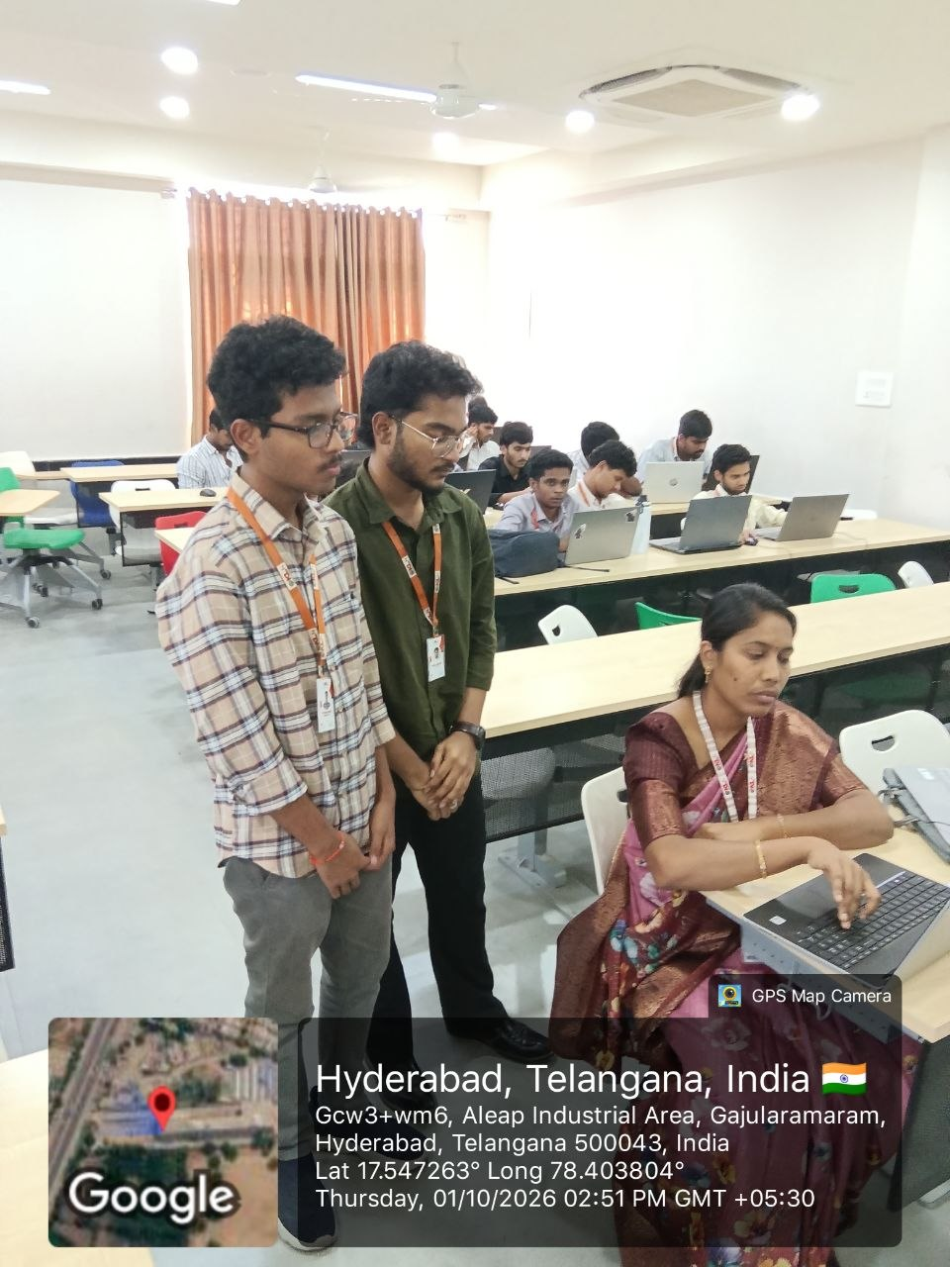
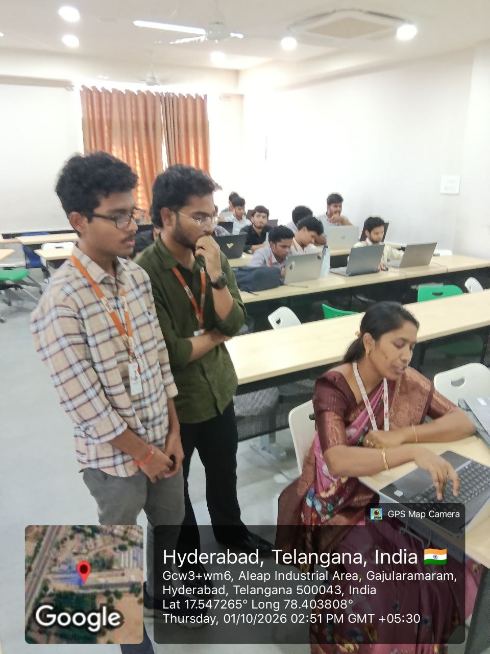
Geotag photos

Slide 17
Thank you

